Slide 1
Did Our Risk Models Warn Us in Time?
Testing portfolio risk models through the 2008 financial crisis
James Beall
Notes:
I'm going to walk you through a project where I tested whether standard risk models gave accurate warnings during the 2007 to 2009 crisis, and what I found when the first results looked wrong.

Slide 2
Bottom line
The problem
The recommendation
Why
A 95% warning line should be crossed about 1 day in 20. In the 2008 crash, ours was crossed about twice as often, because it reacted too slowly.
Use an adaptive model for our warning lines, starting with EWMA, and check it with filtered historical simulation (FHS).
It reacts to new losses within days, not a year. It passed both regulatory tests on both portfolios. It is simple to explain and to audit.
Caveat: during the crash, the adaptive model still crossed its line more often than expected. It is a better standard, not a perfect one.
Notes:
Start with the answer. The problem: our standard warning line is a rolling one-year window, and in the 2008 crash it reacted too slowly. A 95 percent line should be crossed about one day in twenty; ours was crossed about twice as often.
The recommendation: use an adaptive model for warning lines, starting with EWMA, and use filtered historical simulation as a cross-check.
Why: it reacts to new losses within days rather than waiting a year. On both portfolios it passed both regulatory tests. And it is simple enough to explain to a committee and to audit.
Say the caveat before anyone else does: in the concentrated portfolio, the adaptive model still crossed its line more often than expected during the crash. It is a better standard, not a perfect one, which is why the next step is a second-crisis test.

Slide 3
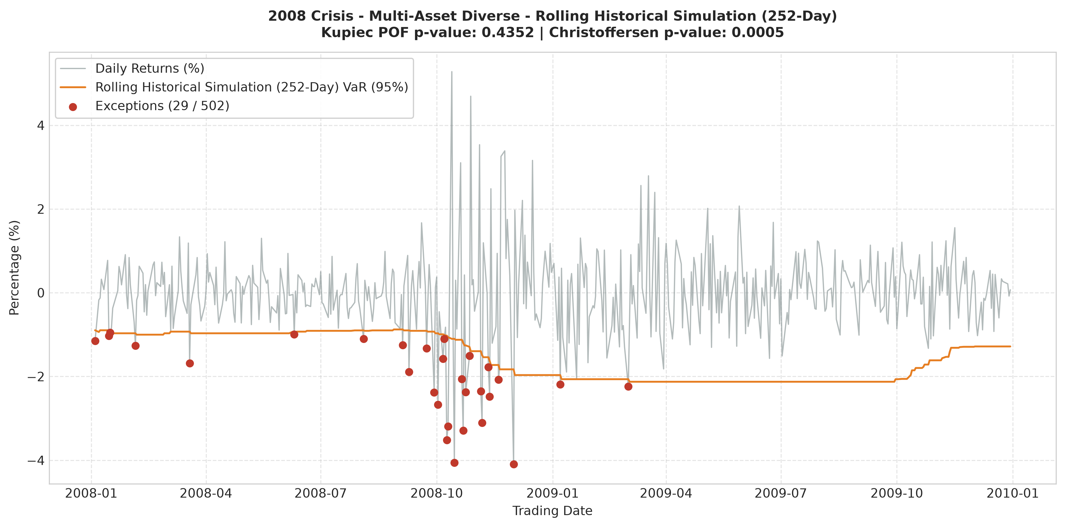
The big picture: the crash
Breaches bunch up in the autumn 2008 crash.
Afterwards the window still holds crash-era losses, so the warning line stays wide through 2009.
After spring 2009, breaches stop, even though the market is still volatile.
Dynamic models adapt faster; the next backup slide compares them on this portfolio.
Notes:
Start with the chart. The grey line is daily returns, and the orange line is the warning line from a rolling one-year window. In autumn 2008 the market falls faster than the window expects, so the breaches cluster. Afterwards the window fills with crash-era losses, so the line stays wide through 2009, and breaches stop in spring 2009 even though markets remain volatile.
This is the diversified portfolio, the same one shown on the second-portfolio backup slide. The concentrated portfolio shows the same pattern more sharply, with more breaches. The dynamic models adapt faster, and the comparison is on the backup slide.

Slide 4
Results: breaches against expected
5 models, 2 portfolios, 502 out-of-sample trading days. Expected: about 25 breaches.
Notes:
Five models, in plain terms. The numbers on this chart are about how each one behaved; these notes are about how each one works.
Rolling historical: it looks back over the last year of daily results, about 252 trading days, and sets the warning line at the level that only the worst five percent of those days fell below. Every day in the window counts equally, and the line only moves as old days drop out. It is the simplest model and the easiest to audit. Its weakness is speed: it does not respond to a crash until the crash days enter the window, and it keeps reflecting them for a year after.
Rolling parametric: the same one-year window, but instead of reading the worst days off the record, it assumes losses follow a bell curve, and sets the line from the average and the typical size of swings. Still simple to explain. The weakness is the bell curve itself: it underweights extreme days, and real crashes are more extreme than a bell curve predicts.
EWMA, the exponentially weighted moving average: there is no fixed window. Each past day counts a little less than the day after it, so the influence of older days fades smoothly. Yesterday matters far more than last year, which is why this model reacts within days of a shock. The fading rate is a standard industry setting. The model still assumes a bell-curve shape for the size of moves, so it inherits some of that weakness in the tails, but it has no year-long memory.
GJR-GARCH: a model that estimates how volatility itself changes over time. It has two features the others lack. First, it treats losses as more destabilizing than gains of the same size, which is called the leverage effect, because markets tend to get more volatile when they fall. Second, its settings are estimated from the data and refit every 21 trading days. It is the most sophisticated of the five and the hardest to explain. It needs ongoing checks, because its settings can shift as the data changes.
FHS, filtered historical simulation: it uses the dynamic volatility estimate from GJR-GARCH, but instead of assuming a bell curve, it uses the actual shape of past standardized shocks. That keeps both the responsiveness to new conditions and the extreme days that actually happened. It is more complex than EWMA, and it depends on the GJR-GARCH volatility model underneath it.
The decision-maker's summary: the first two models are simple but slow. The last three adapt to new conditions, and they get more complex as you go down the list. EWMA is the simplest adaptive option, which is why it is the recommendation.

Slide 5
What went wrong
39
The regulatory test rejected the model (p = 0.008)
Two bugs in my code: volatility misaligned by one day, and parameters fitted on future data
Worse: when the fitting routine failed, it silently returned starting values
The code never crashed. It produced plausible numbers.
breaches in my first version, against about 25 expected
Notes:
This is the important part. The code didn't crash. It produced plausible numbers. A risk model that fails silently is more dangerous than one that fails loudly, because nobody knows to question it.

Slide 6
How I fixed it
1
Fail loudly
The fitting routine raises an error when it doesn't converge.
2
Use only past data
An automated test checks that every forecast uses only earlier days.
3
Check against an independent package
Parameters and volatility paths match a widely used library on three time windows.
4
Test and pin the data
36 automated tests run on every change. Price data is pinned to a fixed snapshot.
Notes:
Each of these changes answers one way a number can be wrong without anyone noticing. The cross-check matters most, because it means I didn't just check my code against itself.

Slide 7
Before and after
A silent bug made a sound risk model look like it failed. Fixing it brought the breach count from 39 to 27.
Before
After
39
27
First version. Failed the regulatory test (p = 0.008).
Fixed version. Passes the regulatory test.
Expected: about 25 breaches over 502 days.
Notes:
Before the fix, the model failed the regulatory test. After the fix, it passes. The bug pointed in the wrong direction here, which is why I'd rather find errors like this before a decision-maker does.

Slide 8
In dollars
Concentrated portfolio, $1,000,000 book, 2007 to 2009 backtest. Average loss past the warning line, per crossing:
$32,641
$20,360
Rolling historical: 46 crossings
Adaptive model (EWMA): 35 crossings
About 38% smaller per crossing. These are backtest figures, not money lost.
Notes:
These are backtest figures, not money that was lost. They show how far losses went beyond each model's warning line on the days it was crossed. The point isn't that one model is magic. It's that choosing and checking a model changes how much exposure you carry into a crisis.

Slide 9
The decision
The problem
The recommendation
Why
Our rolling one-year warning line reacted too slowly to the 2008 crash, and crossings ran about twice the target rate.
Move our warning lines to an adaptive model, starting with EWMA, with FHS as the cross-check.
It reacts within days, passed both regulatory tests on both portfolios, and is simple to explain and audit.
Next step: test the adaptive model on a second crisis before the warning lines go live.
Notes:
Close by restating the three parts, in the same order as the start.
The problem: a rolling one-year window reacted too slowly to the 2008 crash.
The recommendation: move to an adaptive model, starting with EWMA, with FHS as the cross-check.
The why: it reacts within days, it passed both regulatory tests on both portfolios, and a committee can understand and audit it.
Then make the ask explicit. The decision in front of the room is whether to approve a second-crisis test before the warning lines change. That is a small, reversible step, and it is the honest next step.

Slide 10
Limits and next steps
What this doesn't show
Next steps
One crisis and one period tested
Multi-asset independence results rest on very few consecutive breaches
The stress grid is hand-chosen: illustrative, not a forecast
Two of six distressed names lack daily price history
Test a second crisis, such as 2020 or 2022
Find daily data for the distressed names
Run a sensitivity check on the refit schedule
Notes:
I'd rather tell you what this doesn't show than have you find it later. Those limits are also where I'd start if I joined the team.

Slide 11
Backup
Method, troubleshooting, and the second portfolio

Slide 12
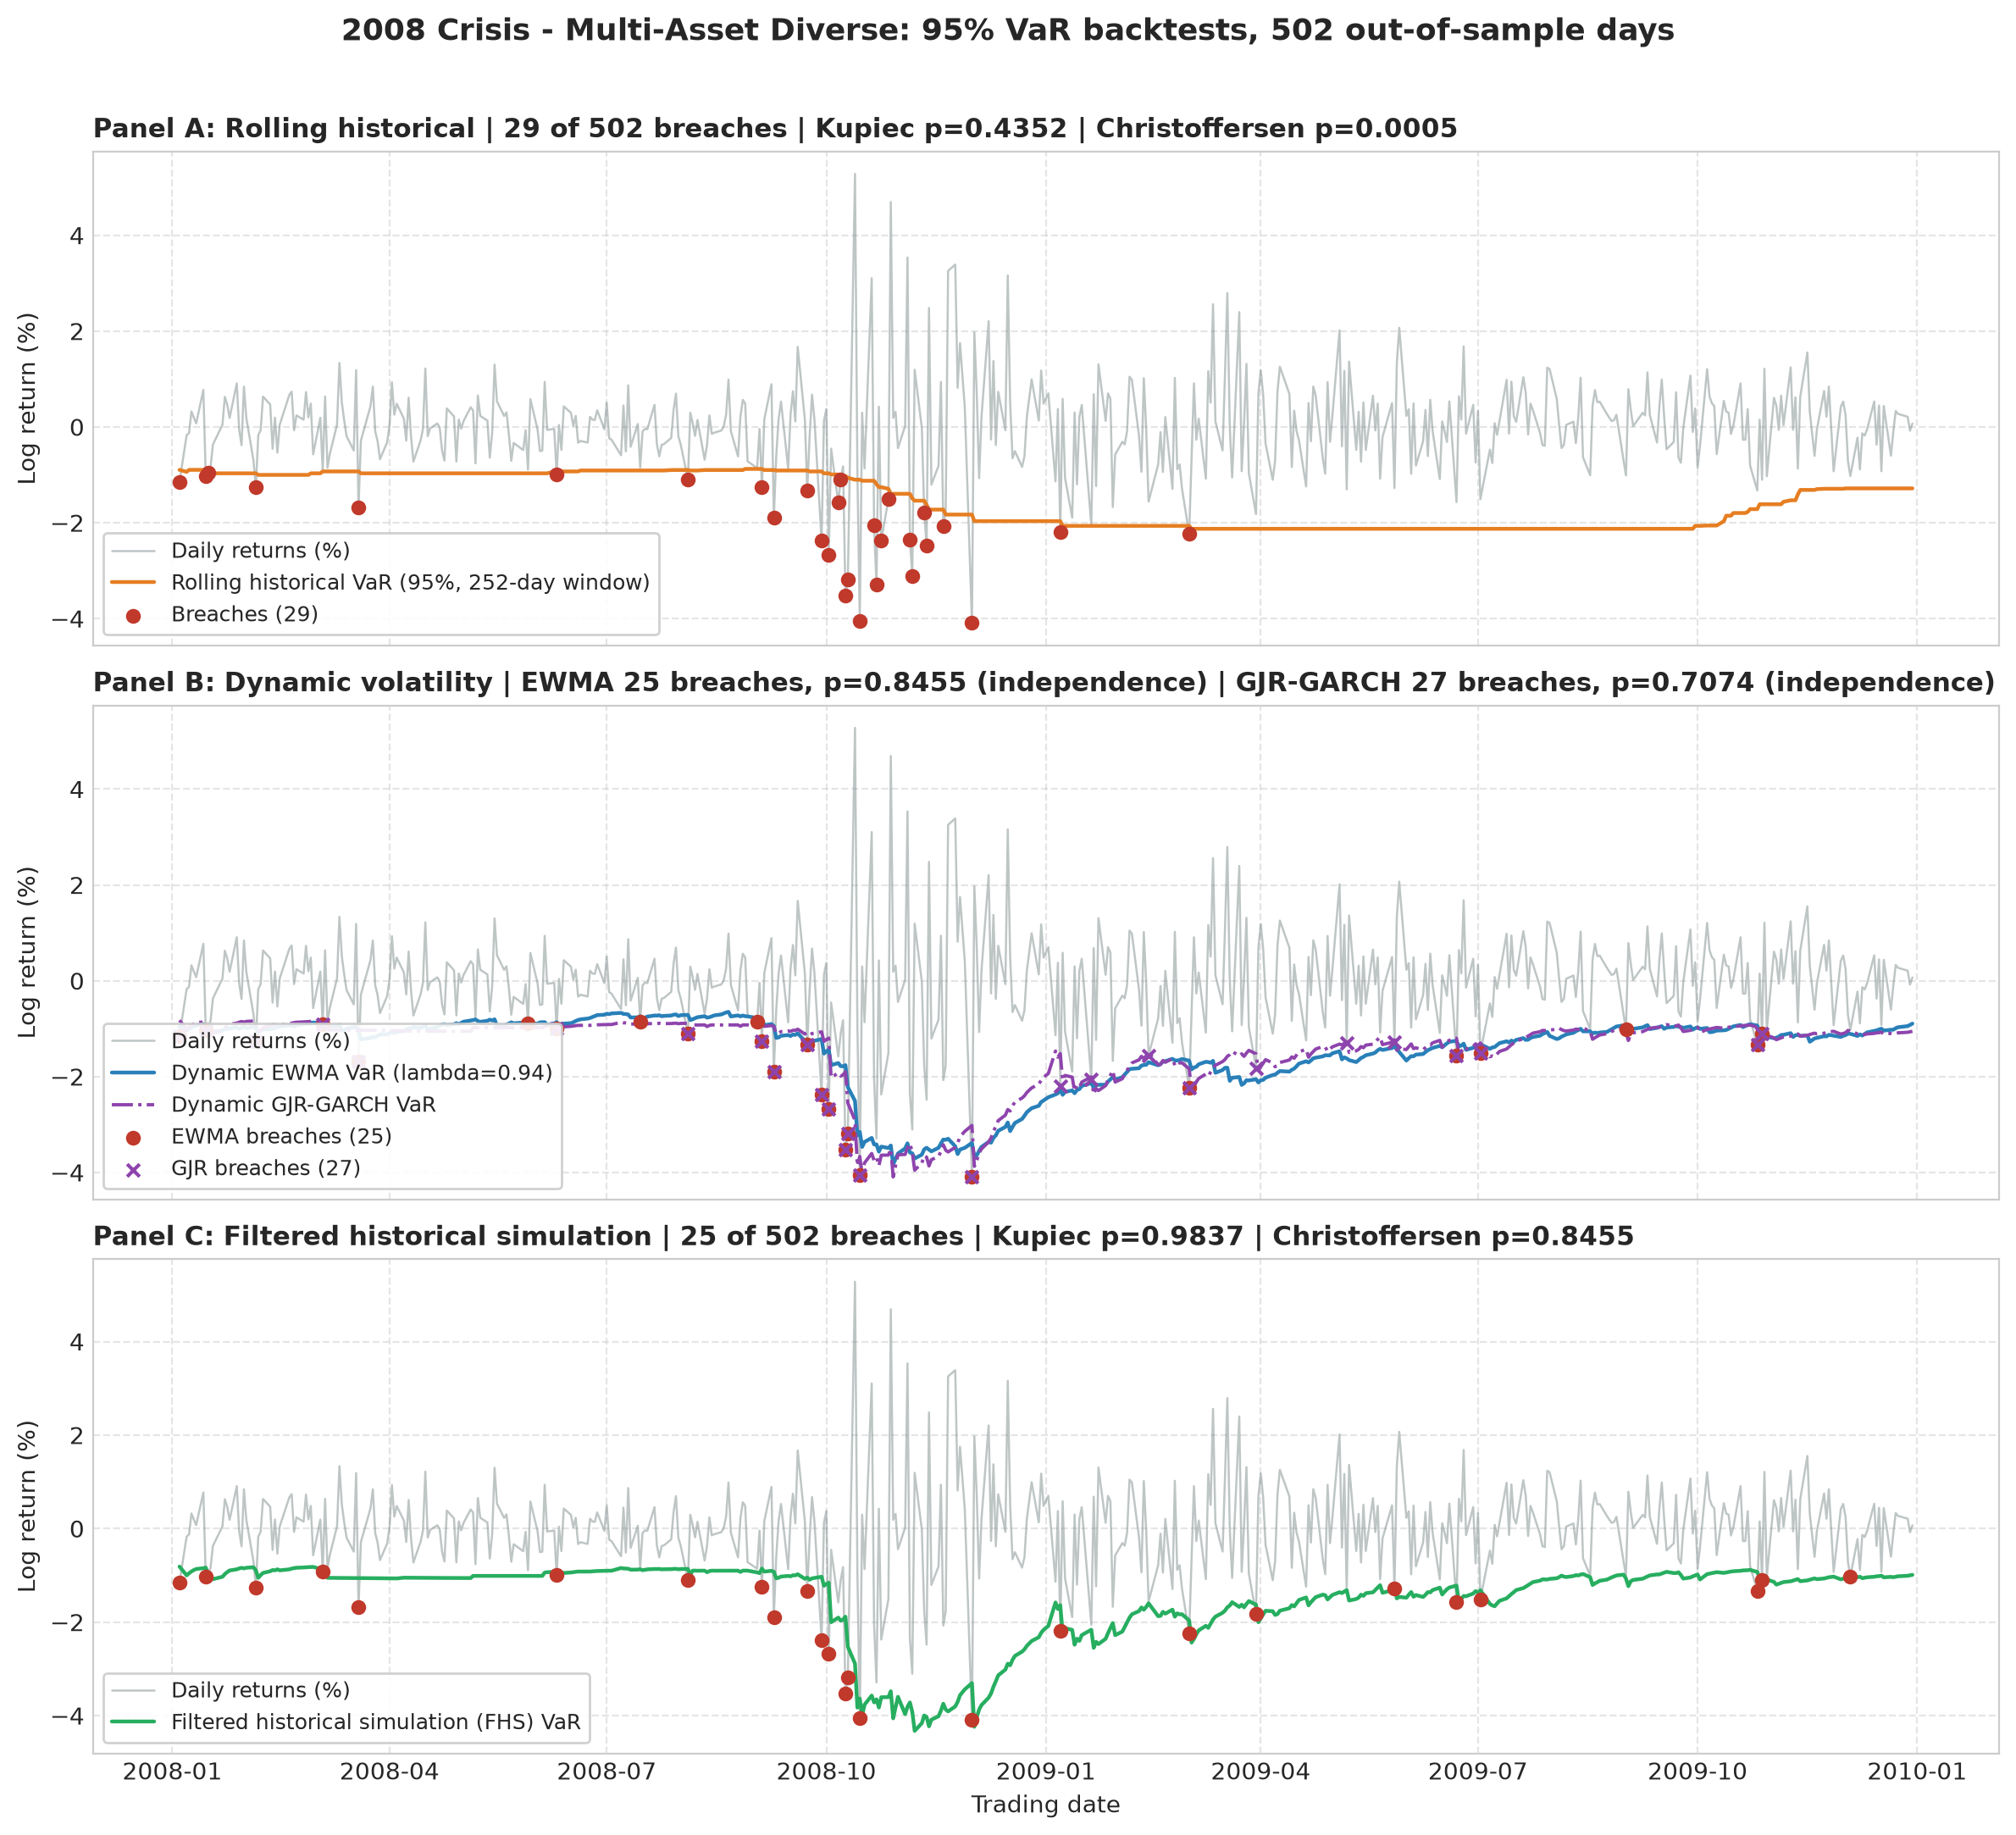
BACKUP
Second portfolio: multi-asset diverse
Rolling historical breaches cluster in autumn 2008, as in the concentrated portfolio.
EWMA, GJR-GARCH, and FHS all pass both tests here.
EWMA and FHS share breach and transition counts. Their thresholds still differ on 8 of 502 days.
Notes:
Use this if the panel asks about the second portfolio. The diversified portfolio is much closer to the expected count for every model, which is why its independence results are weaker evidence.

Slide 13
BACKUP
How breaches are tested
A breach is a day when the loss is larger than the warning line.
Kupiec test: is the breach rate close to 5%? Rejected below p = 0.05.
Christoffersen test: do breaches come one after another? Rejected below p = 0.05.
Both are standard tests used in regulatory backtesting.
Breach counts come from out-of-sample days only: each day is judged using only data available before it.

Slide 14
BACKUP
The bugs, in detail
Volatility misalignment: the forecast for day t was compared with the return from day t-1.
Look-ahead: GJR-GARCH and FHS parameters were fitted once on the full sample, including future days. Now they are refit every 21 days on the trailing 252 days.
Silent fallback: a failed optimizer returned its starting values. Now it raises an error.
Presample convention: the first variance now follows the arch package's rule, which closed the remaining gap in the cross-check.

Slide 15
BACKUP
Cross-check against the arch package
Window | Gamma (ours / arch) | Beta (ours / arch) | Volatility correlation
Days 0–251 | 0.1001 / 0.1001 | 0.7282 / 0.7282 | 1.00000
Days 252–503 | 0.1580 / 0.1580 | 0.8944 / 0.8944 | 1.00000
Days 504–753 | 0.0186 / 0.0186 | 0.9812 / 0.9812 | 1.00000
The volatility paths match to the sixth decimal; log-likelihoods agree within 0.05 once the constant is included.

Slide 16
BACKUP
Reproducibility
Prices come from a pinned snapshot, saved on first download and reloaded on every later run.
Each summary table carries a Data Fingerprint column that identifies the snapshot used.
Re-downloading can revise adjusted prices. Between downloads, the GJR count moved by one breach, while the fit itself repeated exactly on the same data.

Slide 17
BACKUP
The Monte Carlo stress grid
81 scenarios: three volatility tiers, three tail thicknesses, three asymmetry levels, and three shock sizes.
The tier values are chosen by hand, not calibrated to history.
The output shows how distress probability changes across assumptions. It is a sensitivity analysis, not a forecast.

